Slide 1


Disparate interactions: an algorithm-in-the-loop analysis of fairness in risk assessments
April 11, 2019
B. Green, Y. Chen, 2019 FAT Conference
Review presented by
Mai Lee Chang, Marius Arvinte
The University of Texas at Austin

Slide 2
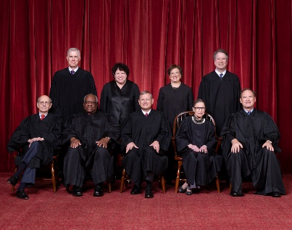

Introduction
Classical decision-making process relies 100% on human expertise/experience.
Decision-making process
Judge
Observes defendant
Pretrial arrest?
Bias/inaccuracy reflects here vs. ground truth
Possibly biased
Possibly inaccurate

Slide 3
Introduction
ML-aided decision-making process incorporates aid from well-trained, fine-tuned ML models.
We expect this to lead to fairer decision-making… right?
Decision-making process
Judge
Observes defendant
Pretrial arrest?
Risk assessment
ML Model
e.g., COMPAS

Slide 4
Introduction
… Wrong! → This is what this paper experimentally proves.
Decision-making process
Judge
Observes defendant
Pretrial arrest?
Even more bias!
Risk assessment
ML Model
Accurate, fair

Slide 5
Related Work
2011 Kentucky legal system study
Risk assessment model recommends immediate non-financial release in >90% of cases.
In practice, judges only release on ≈ 35% of cases and using the model doesn’t change things.
Automation bias [Mosier ‘98]
First work to show that automated tools influence (badly) human decisions.
Omission errors = People do not recognize when automated tools fail.
Commission errors = People follow automated systems without considering contradictory information.
Algorithm aversion [Dietvorst ‘15]
People are (way) less tolerant of errors made by algorithms than by other people

Slide 6
Disparate Interactions
The extra bias is coming from disparate interaction.
When evaluating black defendants, participants are:
More strongly influenced to increase their risk prediction.
More likely to deviate from the ML model towards higher levels of risk.
This paper is heavily experimental via Amazon Mechanical Turk.
The authors will reveal the disparate interaction phenomenon, but the paper ends abruptly.
Algorithm-in-the-loop is only suggested, never proposed or used, even though it is in the title.

Slide 7
The Experiment
Test three hypotheses:
Performance = Participants presented with a model will make less accurate predictions than the model.
Humans don’t trust enough to copy-paste the algorithm.
Evaluation = Participants will be unable to accurately evaluate their own and the model’s performance.
Sometimes humans take (apparently) unstructured decisions.
Bias = As they interact with the model, humans will increase risk predictions for black people (vice versa for white).
TBD

Slide 8
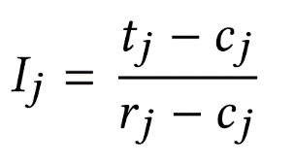
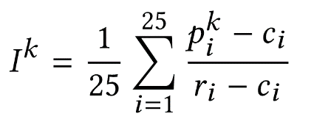
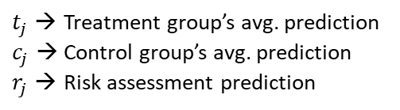
Model and Metrics
Train a gradient boosted tree to predict violation of pretrial release on DOJ dataset.
Achieve AUC 0.67, comparable to COMPAS and PSA.
Ensure the model is well calibrated for risk scores between 10%-60%.
Similar false positive rate to COMPAS (higher for blacks!).
For each defendant, measure the risk score influence:
$t_{j}$ → Treatment group’s avg. prediction
$c_{j}$ → Control group’s avg. prediction
$r_{j}$ → Risk assessment prediction
For each participant, measure the risk assessment model influence:
$p_{i}^{k}$ → Participant k’s prediction about the i-th defendant.

Slide 9
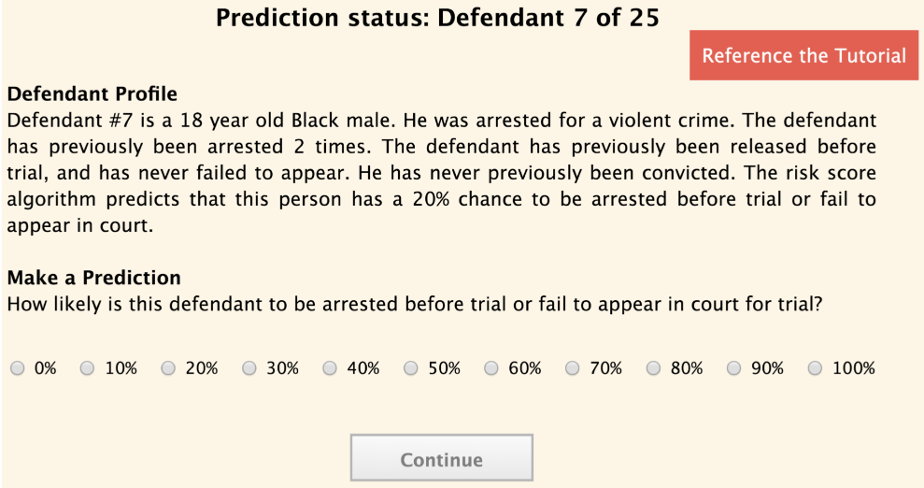
Human-Subjects Experimental Design
Task
Assess the likelihood that criminal defendants who have been arrested will:
Commit a crime
Fail to appear in court if they are released before trial
20 min

Slide 10
Human-Subjects Experimental Design
Procedure
Consent
Tutorial (task description, pretrial release background info)
Comprehension task
Intro survey
Series of predictions (25)
Exit survey
Independent Variable
Control Group: demographic info
Treatment Group: demographic info + risk assessment’s prediction
Design: between-subjects study
Notes:
Series of predictions: each participant was presented with narrative profiles about a random sample of 25 defendants drawn from the 500-person experiment sample population.
Participants were paid $2 for survey + max reward of $2 based on their performance during the experiment

Slide 11
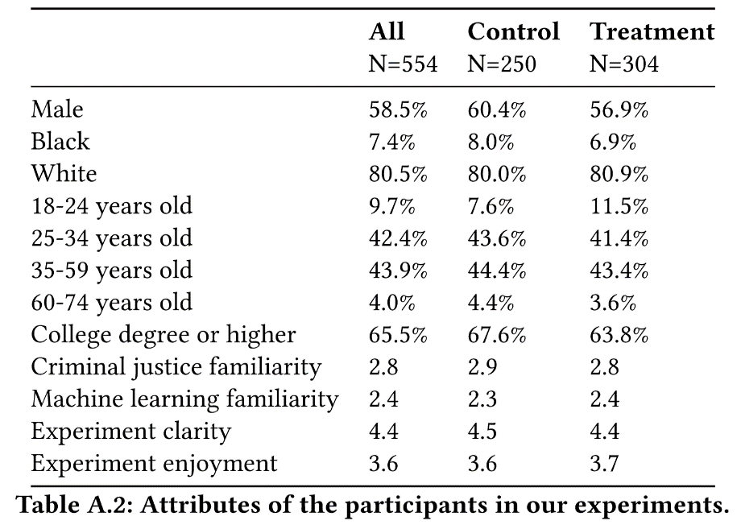
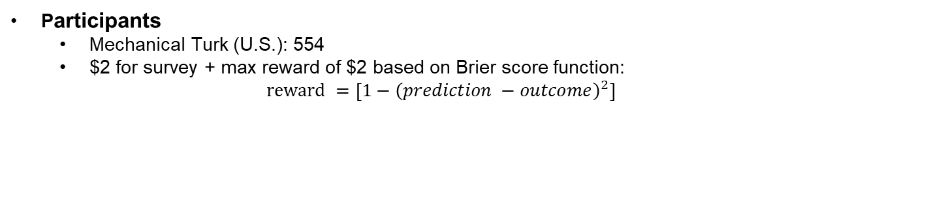
Human-Subjects Experimental Design
Participants
Mechanical Turk (U.S.): 554
$2 for survey + max reward of $2 based on Brier score function:
$$reward =\left[1−{\left(prediction −outcome\right)}^{2}\right]$$
1,350 more predictions in Treatment Group
Notes:
False positive rates using a threshold of 50%
1-5 rating scale

Slide 12
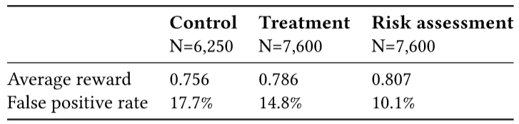
Results (H1 – Performance)
Notes:
There were significant differences between all the groups for average reward and false positive rate.
Treatment Group outperformed the Control group but underperformed the Risk Assessment Group.

Slide 13
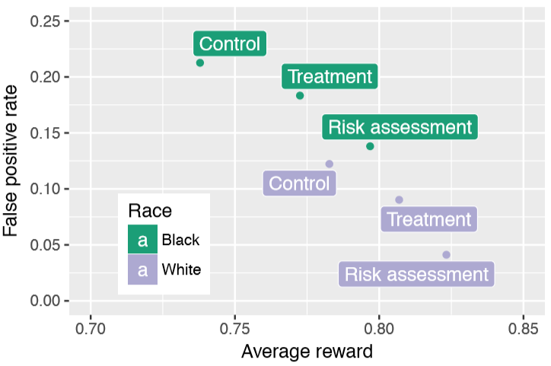
Results (H1 – Performance)
Notes:
Results were broken down by race to see how participants performed when making predictions about black and white defendants.
Overall, the Risk Assessment Groups performed the best followed by the Treatment Group then the Control Group.
Actual performance level differs significantly across race. That is:
All three predictions achieve a larger reward and lower false positive rate for white defendants than for blacks.
Take-away message: People underperform risk assessments even when provided with its advice

Slide 14
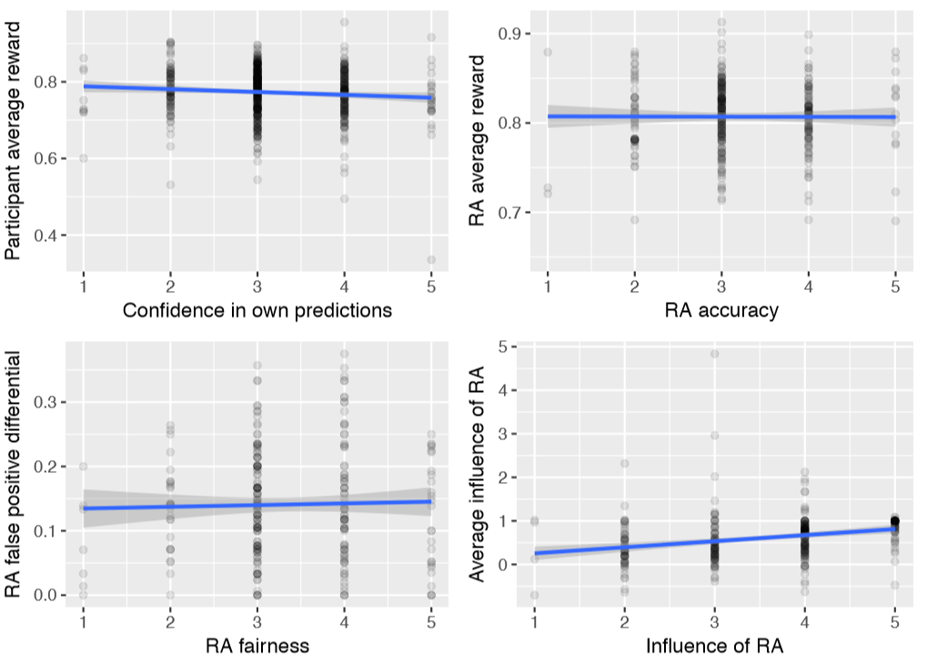
Results (H2 – Evaluation)
(Not at all)
(Extremely)
Notes:
X-axis is participants’ ratings
Dot = participant
To assess whether participants could evaluate the quality of their predictions, their self-reported confidence was compared against their actual performance.
They regressed confidence on performance while controlling for each participants’ treatment, demographic info, and exit survey responses and found:
Avg reward was negatively associated with confidence → more confidence expressed, actually performs less/lower
Next analysis looked at whether participants in the treatment group could evaluate the risk assessment’s accuracy.
No significant relationship between the participants’ perception of the risk assessment’s accuracy and its true performance
Suggests participants were unable to perceive any diff in risk assessment accuracy
Can participants discern how fairly the risk assessment made predictions
No significant relationship between perceived and actual fairness
Can participants recognize how much they incorporated the risk assessment into their decisions?
Yes, participants could generally discern how much they were influenced by the risk assessment.
Take-away message: People are unable to evaluate their own performance or the risk assessment’s

Slide 15
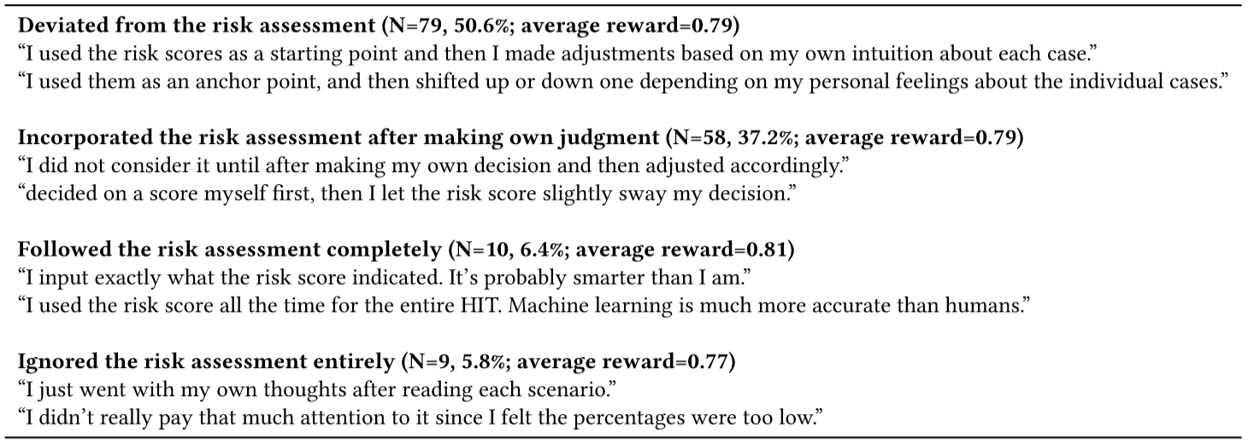
Results (H3 – Bias)
Disparate interactions
Notes:
The two most common strategies yields evidence for “disparate interactions” which are interactions with the risk assessment that lead participants to disproportionately make higher risk predictions about black defendants and lower risk predictions about white defendents.

Slide 16
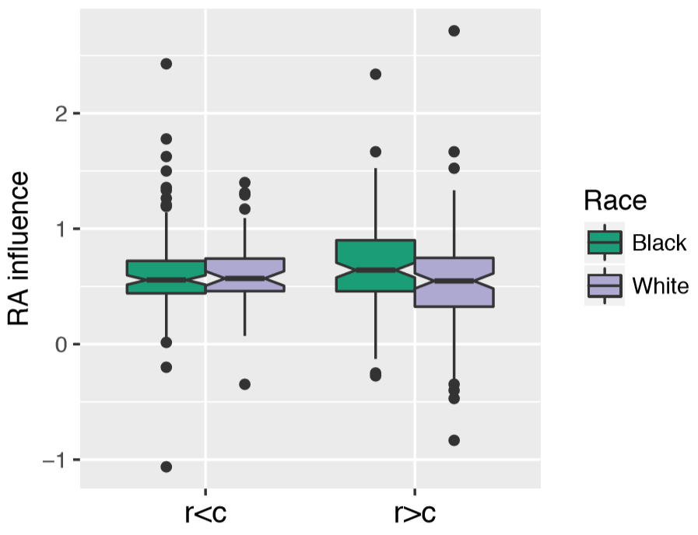
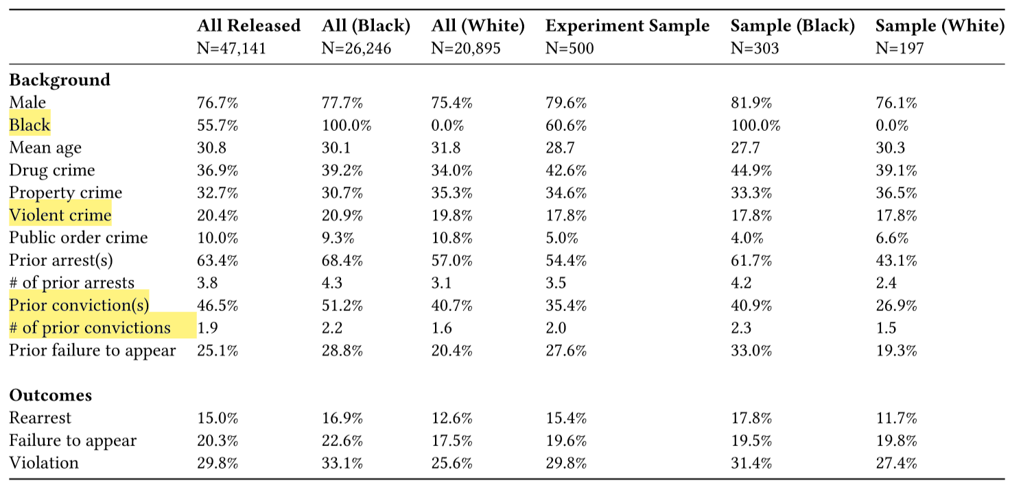
Results (H3 – Bias)
Notes:
Influence of risk scores
Split defendants by race
When risk score is lower than control group’s average prediction (r<c), the risk assessment exerted a similar influence on participants regardless of the defendant’s race.
Yet, when r>c, the risk assessment exerted more influence on predictions about black defendants than whites.
To explain this result, they regressed the risk score’s influence on each defendant on that defendant’s demographic attributes and criminal background
Risk assessment exerted more influence on participants making predictions about:
Black defendants
Defendants who were arrested for a violent crime
Defendants with more prior convictions
Participants were more strongly influenced to increase their risk predictions for black defendants in two ways:
Race
Feature that is correlated with race
Take-away message: People engage in “disparate interactions”

Slide 17


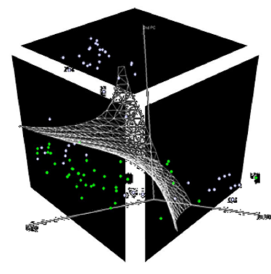

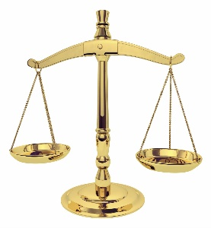
Algorithm-in-the-Loop Framework
?
Notes:
Knowledge gap of algorithm’s sociotechnical properties: whether and how they actually improve decision-making
Recent work related to interpretability provides one important direction where progress is already being made.
A common approach is to …
Lastly, given that automation can induce moral buffer, it’s necessary to study people’s sense of responsibility for their decisions.
The paper would be stronger if the authors actually proposed a framework.

Slide 18

Algorithm-in-the-Loop Framework
?
Notes:
Knowledge gap of algorithm’s sociotechnical properties: whether and how they actually improve decision-making
Recent work related to interpretability provides one important direction where progress is already being made.
A common approach is to …
Lastly, given that automation can induce moral buffer, it’s necessary to study people’s sense of responsibility for their decisions.
The paper would be stronger if the authors actually proposed a framework.

Slide 19

Algorithm-in-the-Loop Framework
?
Notes:
Knowledge gap of algorithm’s sociotechnical properties: whether and how they actually improve decision-making
Recent work related to interpretability provides one important direction where progress is already being made.
A common approach is to …
Lastly, given that automation can induce moral buffer, it’s necessary to study people’s sense of responsibility for their decisions.
The paper would be stronger if the authors actually proposed a framework.

Slide 20
Algorithm-in-the-Loop Framework
No framework proposed
Alternative approaches?
Notes:
Knowledge gap of algorithm’s sociotechnical properties: whether and how they actually improve decision-making
Recent work related to interpretability provides one important direction where progress is already being made.
A common approach is to …
Lastly, given that automation can induce moral buffer, it’s necessary to study people’s sense of responsibility for their decisions.
The paper would be stronger if the authors actually proposed a framework.

Slide 21
Algorithm-in-the-Loop Framework: Potential Approach
Challenging!
Notes:
Knowledge gap of algorithm’s sociotechnical properties: whether and how they actually improve decision-making
Recent work related to interpretability provides one important direction where progress is already being made.
A common approach is to …
Lastly, given that automation can induce moral buffer, it’s necessary to study people’s sense of responsibility for their decisions.
The paper would be stronger if the authors actually proposed a framework.

Slide 22
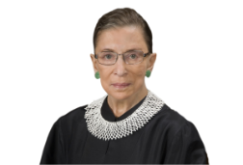
Summary
1
ML Model
Accuracy
ML Model
0
Fairness
1

Slide 23

Summary
1
ML Model
?
?
Accuracy
ML Model
Disparate interactions
0
Fairness
1
Notes:
Main findings:
People underperform risk assessments even when provided with its advice
People are unable to evaluate their own performance or the risk assessment’s
People engage in “disparate interactions”

Slide 24
Thank you!

Slide 25
Limitations
Mechanical Turk workers instead of real judges
Difference in the amount of race-related information (physical appearance)
Long-term implications
Judges see the outcomes of their decisions
Fairness of risk assessment affects results?

